Slide 1
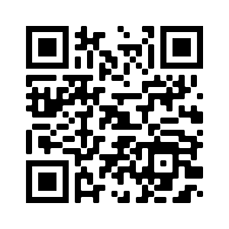
Ward / Department Learning Summary
What Matters to You? Conversation and Learning Tool (1B)
We asked______ (#) patients what matters.
____(#) of staff reported this question enhanced their conversation.
____(#) of staff learnt something new.
____(#) of staff changed an aspect of their care / intervention as a result.
Input your results here!
They will be analyzed and fed back to your team.
We asked patients...
They said...
We did...
Changes we plan on making in the future as a result:
[Add your organizations logo here]
Join What Matters To You Day 2021 by tweeting using #wmty.world #wmty21

